Slide 1

A Case study on Repaying the Credit
Kavindra Raj
Notes:
Line spacing + Page numbers

Slide 2



Introduction
Loan analysis involves evaluating a borrower's creditworthiness and the risk associated with lending to them. This case study will explore how a lending institution can use loan analysis to improve their lending process by analyzing various factors such as credit amount, income, education, assets and purpose for the loan. Lending institutions can make informed decisions about whether to approve or deny a loan application. By analyzing loan data and identifying trends, lending institutions can make changes to their lending policies and procedures to better serve their customers and improve their overall lending process.

Slide 3
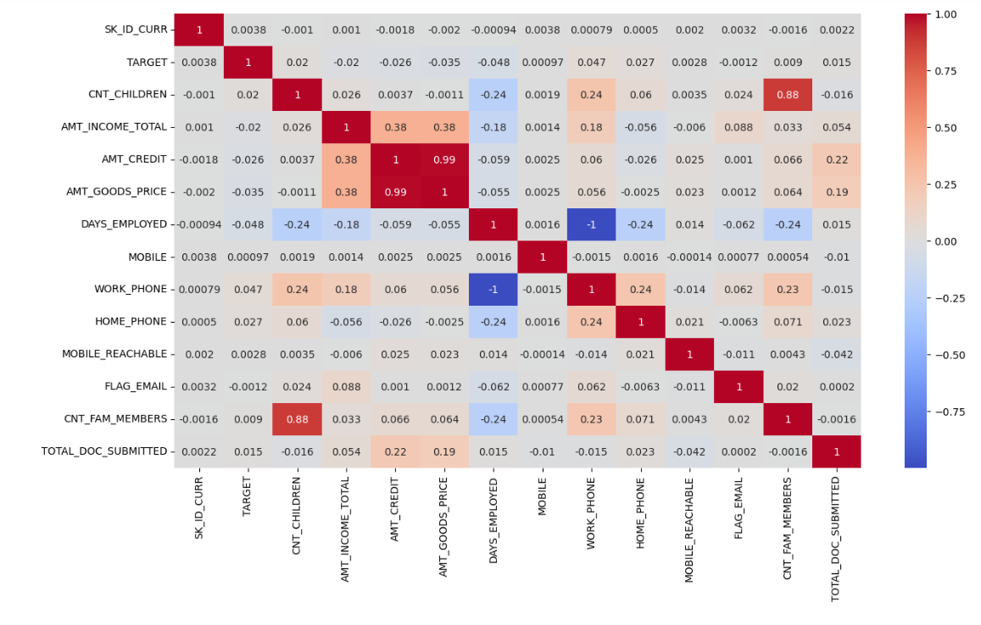
Correlation Btw Various columns in the DataSet
Very High Positive
Correlation
1.Cnt-Family members vs Cnt-Childern
2.Amount goods price vs amount credit.
Moderate Positive Correlation
1.Amount income total vs Credit Amount

Slide 4
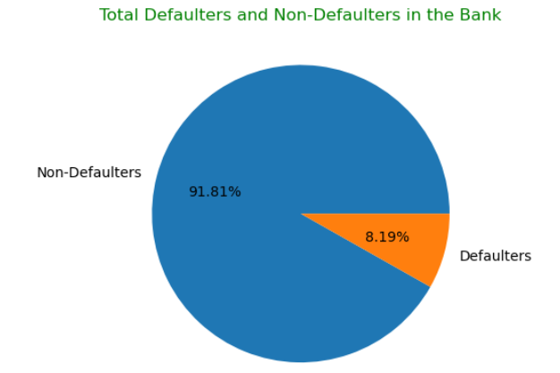
Total Number of Defaulters and Non-Defaulters in the Bank

Slide 5

ANALYSIS FOR
DEFAULTERS

Slide 6
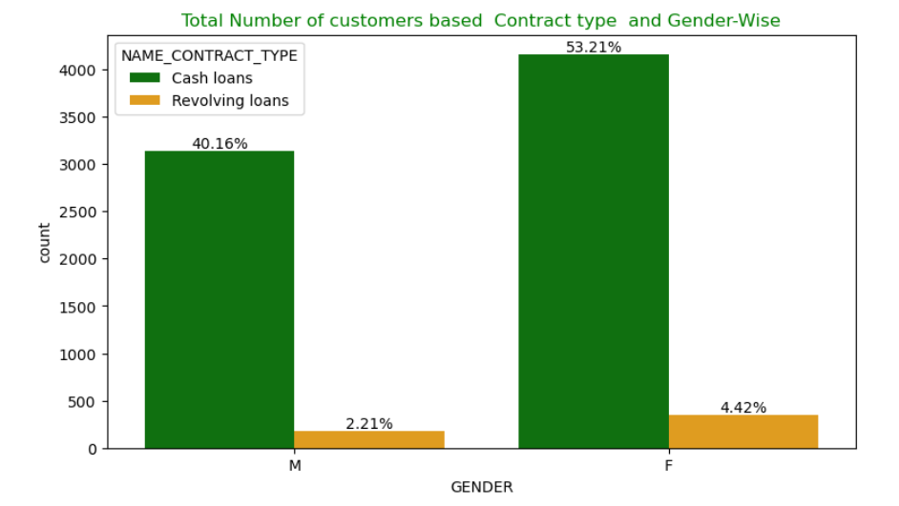
Total Number of customers based Contract type and Gender-Wise

Slide 7
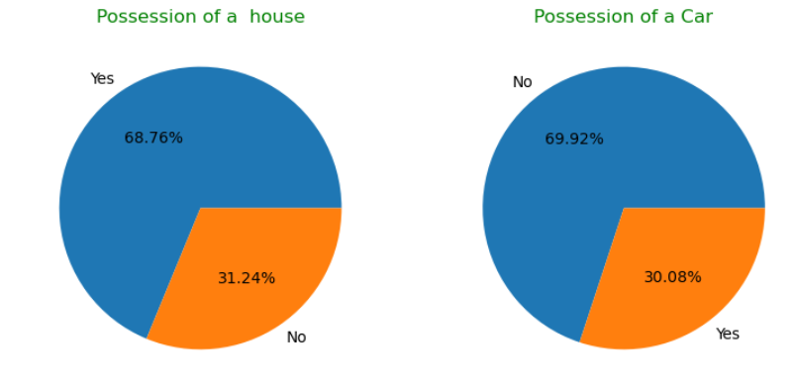
Possession of a House and Car
68.7% of customers own a car and 69.92% customers dont own a Car.

Slide 8
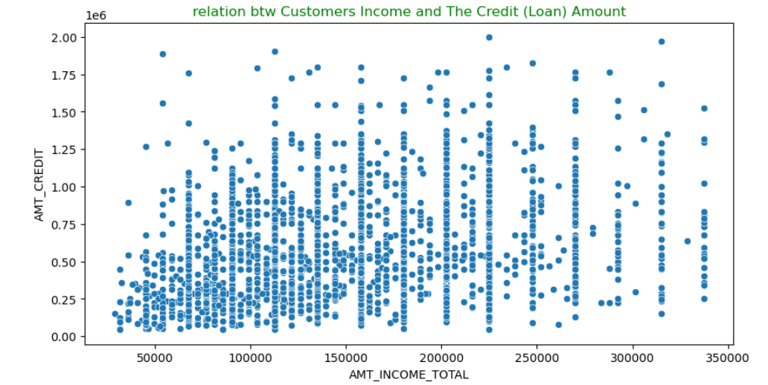
Relation between Customers Income and The Credit (Loan) Amount
There isn’t a specific pattern we can observe but we can see that More number of loans near 50000 to 150000 Income Amount

Slide 9
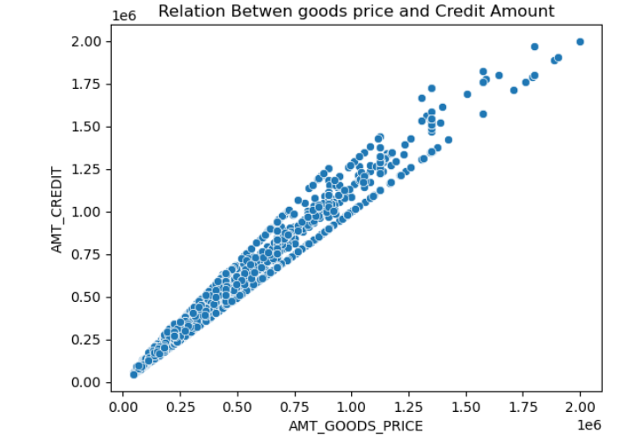
Relation Between goods price and Credit Amount
Strong positive Correlation btw Amount goods price and Amount Credit

Slide 10
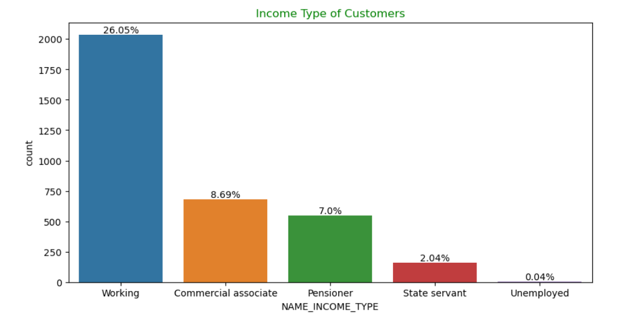
Income Type of Customers
26.05% workers defaulted the maximum cash loans.

Slide 11
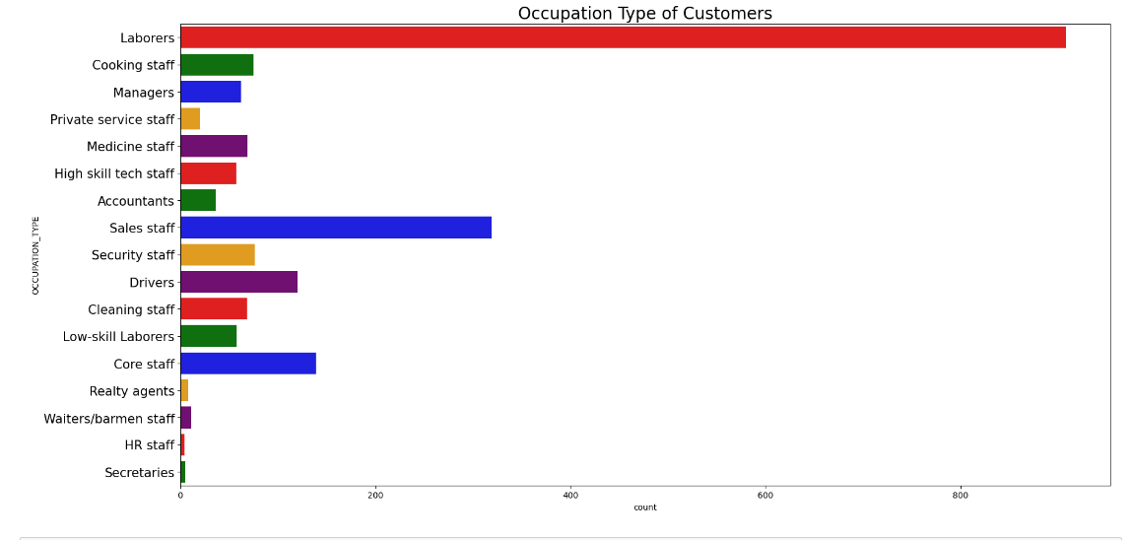
Occupation Type of Customers
Around 850 Customers are Laborers

Slide 12
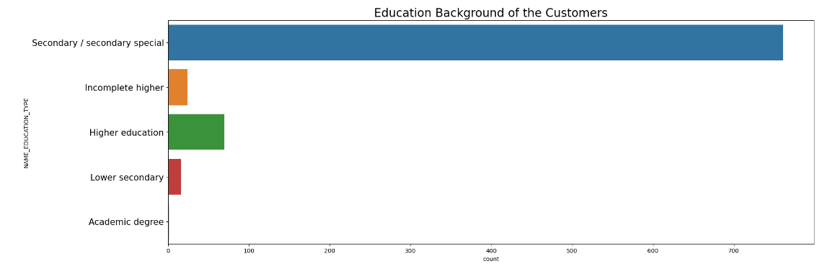
Education Background of the Customers
The majority of customers are laborers and they had Secondary/Secondary special Education Background.

Slide 13
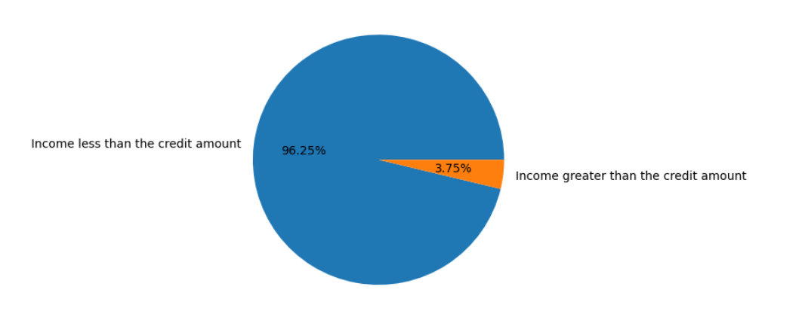
Customers Income compared to Credit Amount.
The 96.25 % defaulters had income less than the Credit Amount.

Slide 14
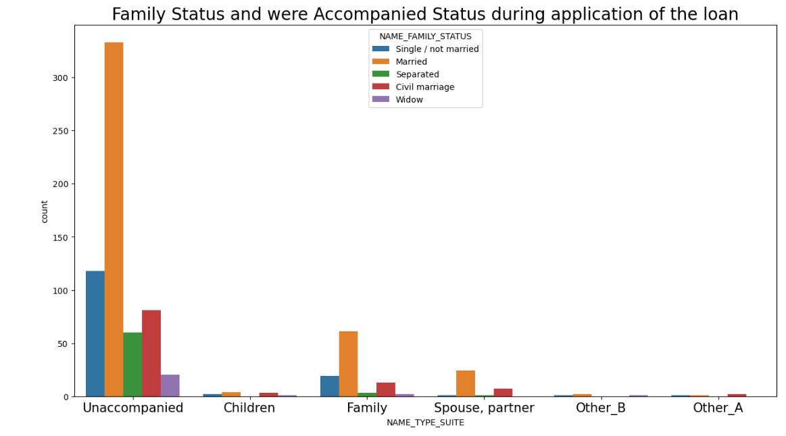
Family Status and were Accompanied Status during application of the loan
The majority of customers are married and were not accompanied by anyone when they came to apply for the loan.

Slide 15
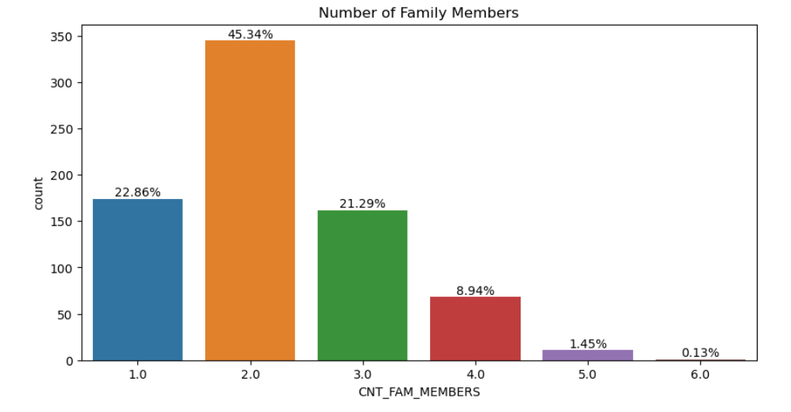
Number of Family Members
45.34 % Customers have 2 Family Members.

Slide 16
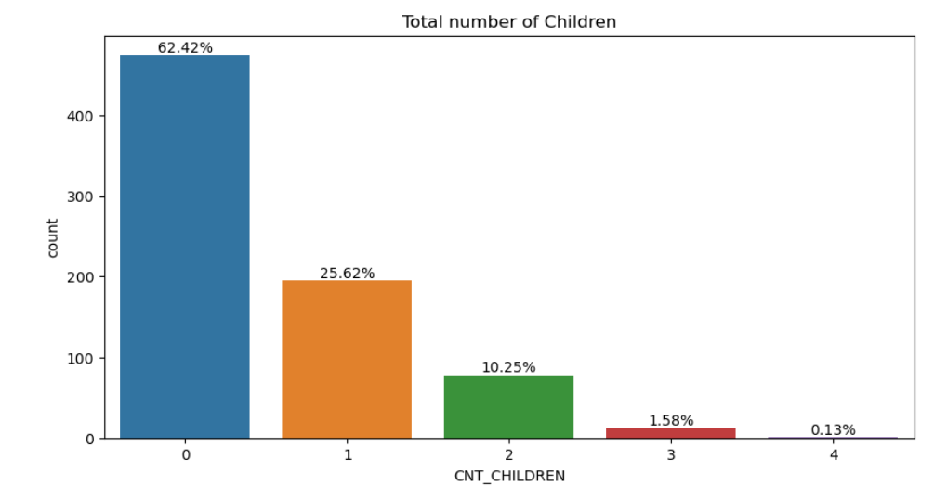
Number of Children
62.42% of Customers have No children.

Slide 17
Central Tendency of Income and Credit Data
Credit Amount
Loan Amount
Gender | Mean | Median | Std.Deviation | Mean | Median | Std.Deviation
Female | 546972.48 | 472500.0 | 316283.06 | 135814.97 | 121500.0 | 53387.78
Male | 541058.98 | 491179.5 | 286555.12 | 159188.55 | 157500.0 | 56005.71
The mean credit amount for females is slightly higher than that for males, but the standard deviation is also higher, indicating that there is more variability in the credit amounts for females. The median credit amount for females is lower than that for males, suggesting that there may be more females with lower credit amounts compared to males.

Slide 18
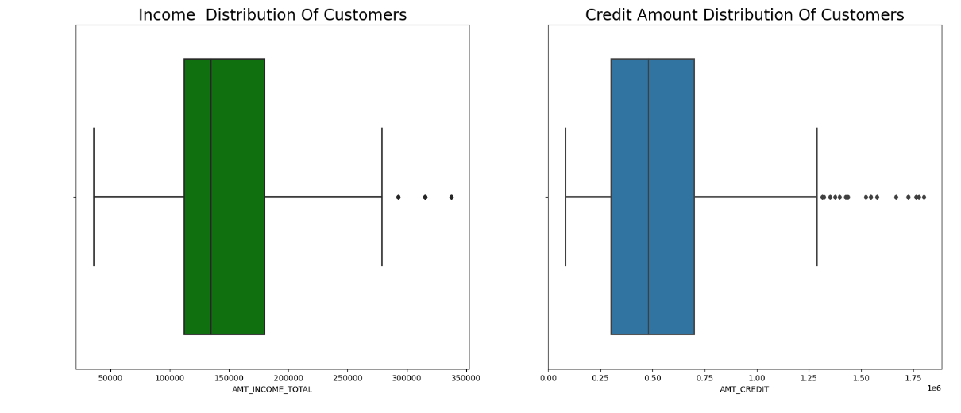
Credit Amount and Income Distribution Of Customers
Income is between 120000 and 180000 for maximum number of employees.
Credit amount is between 300000 and 700000 for maximum number of employees

Slide 19
Cash Loan should be Rejected 1. The customers were married laborers from the working class. 2.They owned a house but did not have a car. 3.They were unaccompanied when they came to apply for the loan. 4.Their income was less than the credit amount. 5.The goods price was almost equal to the credit amount. 6. 53.21% were females among these defaulters. Family Background 1. 62.42% customers had no children. 2. 45.34% customers had 2 family members. The fact that the customers' income is less than the credit amount could be viewed as a negative factor, as it suggests that they may have difficulty making payments on the loan if it is granted. The fact that the goods price is almost equal to the credit amount could be viewed as a potential risk factor, as it suggests that the customers may not have much financial assets. While the customers own a house, they do not have a car, which means that they may not have sufficient collateral to secure the loan.
Takeaways

Slide 20

ANALYSIS FOR
NON-DEFAULTERS

Slide 21
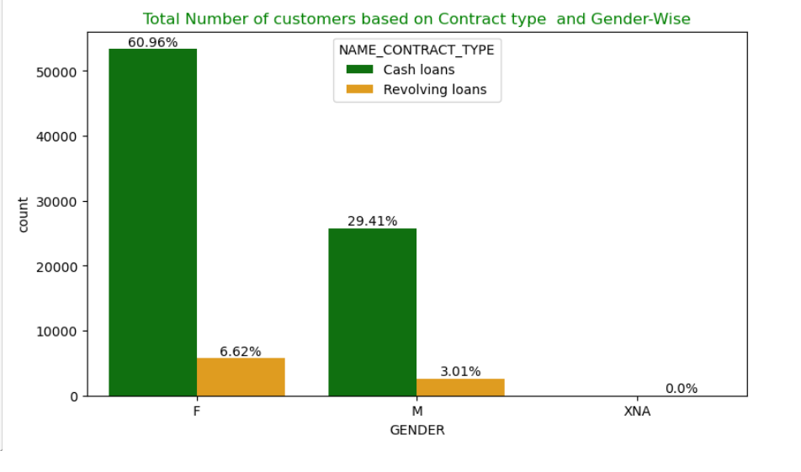
Total Number of customers based Contract type and Gender-Wise

Slide 22
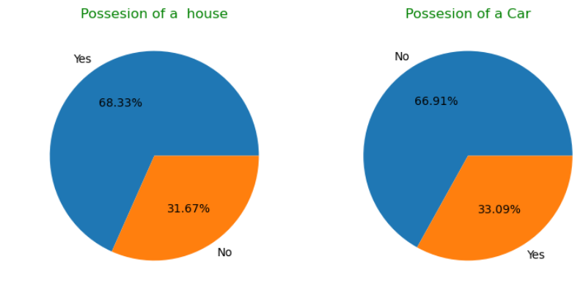
Possession of a House and Car
68.33% of customers own a car and 66.91% customers dont own a Car.

Slide 23
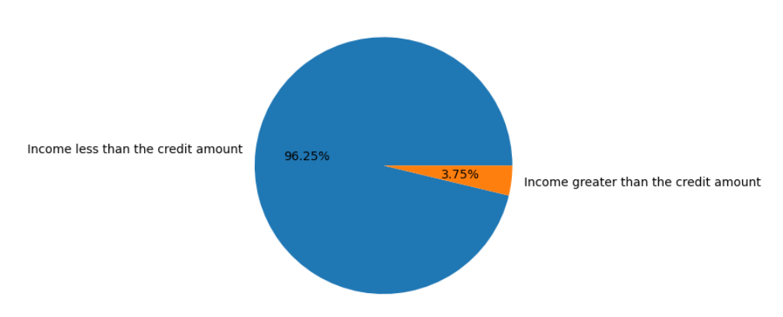
Customers Income compared to Credit Amount.
The 96.25 % customers have income less than the Credit Amount.

Slide 24
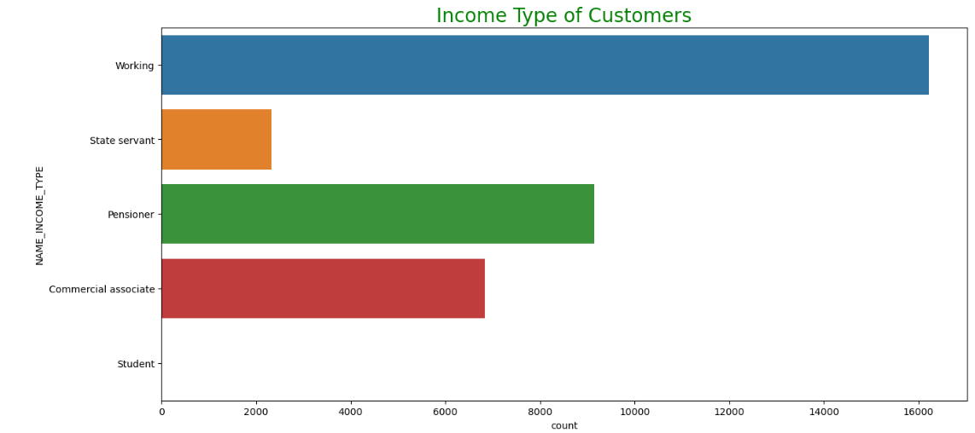
Income Type of Customers
Around 16000 workers are from the Working Class.
Pensioner and Commercial Associate have around 16000 customers.

Slide 25
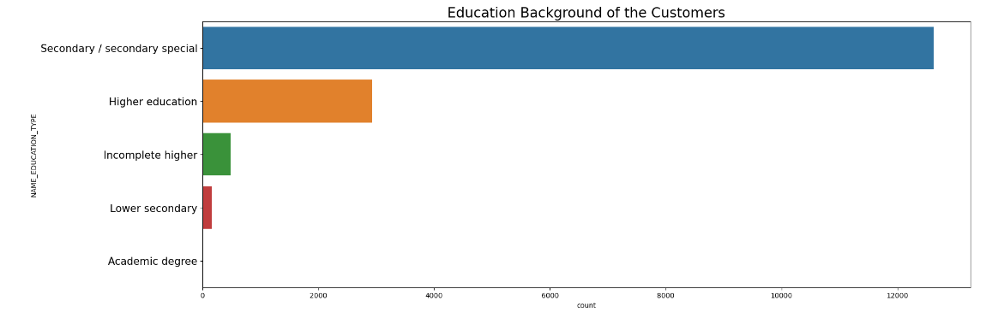
Education Background of the Customers Belonging to Working Class
More than 12000 Customers are laborers and they had Secondary/Secondary specical Education Background.

Slide 26
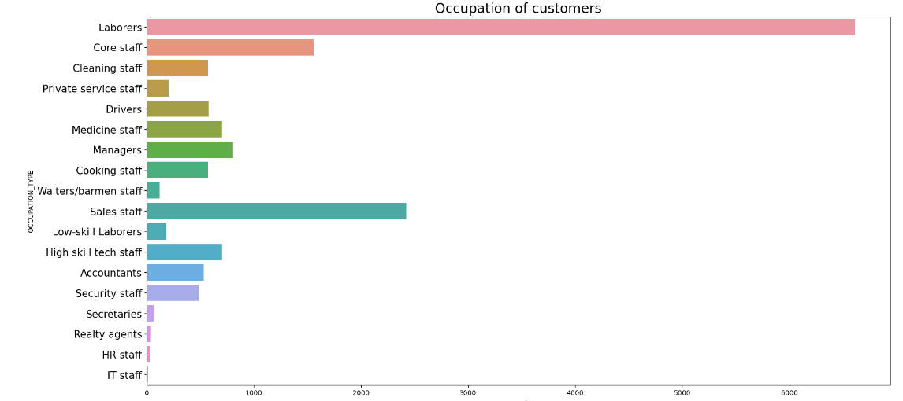
Occupation Type of Customers Belonging to Working Class
6000+ Customers are Laborers

Slide 27
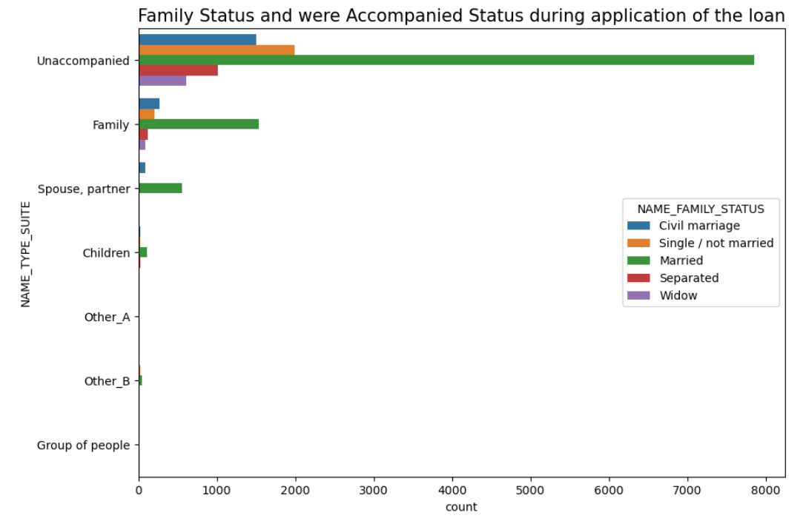
Family Status and Accompanied Status during application of the loan of Working Class Customers.
The majority of customers are married and were not accompanied by anyone when they came to apply for the loan.

Slide 28
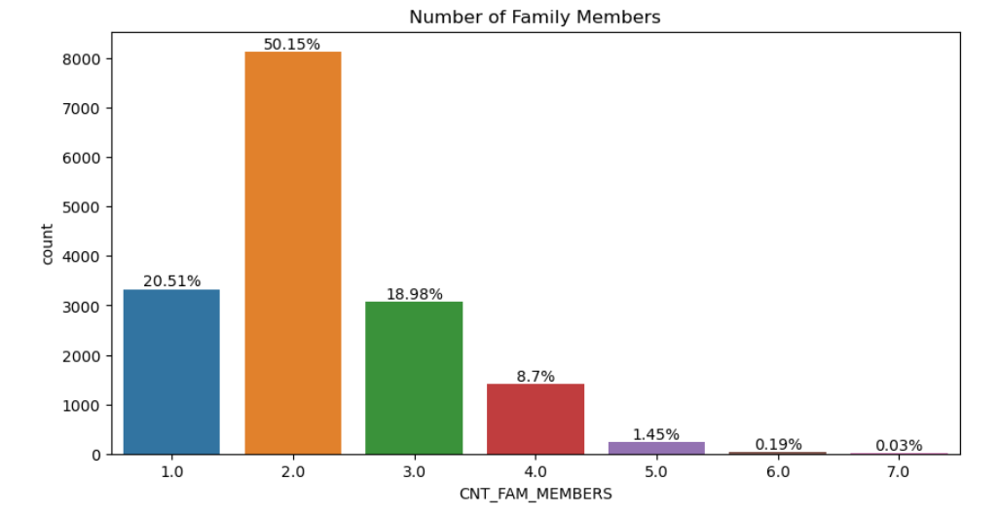
Number of Family Members of Working Class customers
50.15 % Customers have 2 Family Members.

Slide 29
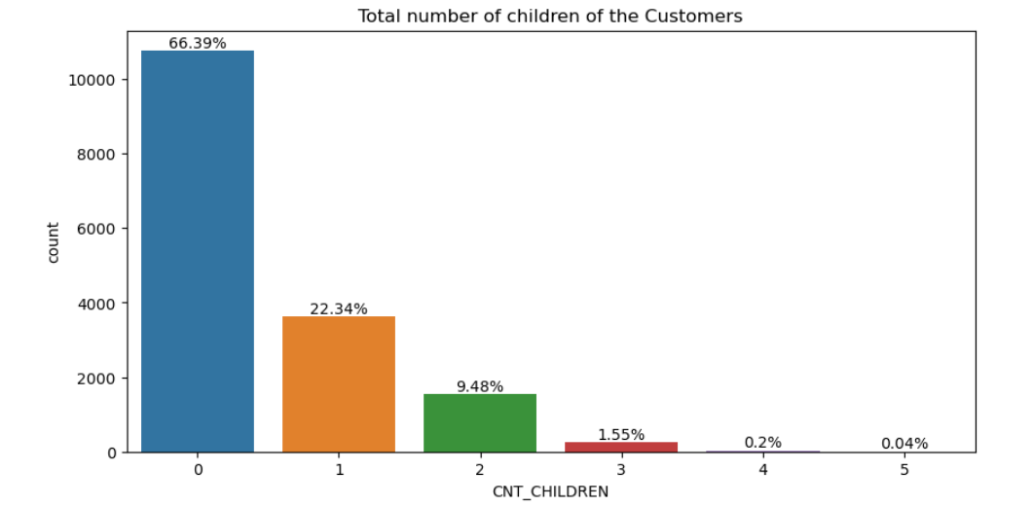
Number of Children of Working Class customers
66.39 % of Customers have No children.

Slide 30
Central Tendency of Income and Credit Data of Working Class Customers
Credit Amount
Income Amount
Gender | Mean | Median | Std.Deviation | Mean | Median | Std.Deviation
Female | 600988.89 | 536917.5 | 360965.95 | 141148.95 | 135000.0 | 57973.46
Male | 578501.47 | 513531.0 | 345046.81 | 158390.76 | 148500.0 | 58808.31
For Income-
the mean and median values are higher for males compared to females. This suggests that, on average, males have a higher income than females. The standard deviation for both genders is also quite large, indicating a wide range of income levels.
For Credit-the mean and median values are higher for females compared to males. This suggests that on average, females are receiving higher loan amounts than males. The standard deviation for both genders is quite large, indicating a wide range of loan amounts.

Slide 31
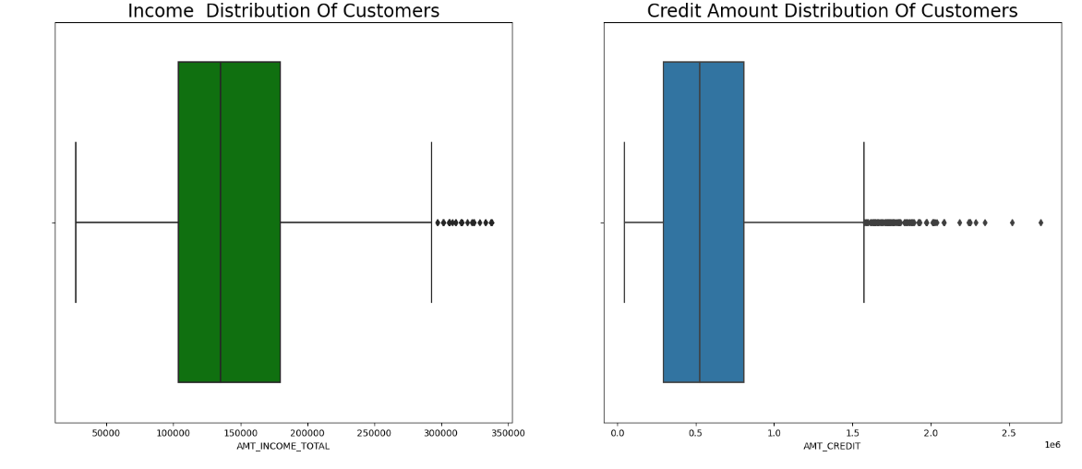
Credit Amount and Income Distribution Of Working Class customers
Income is between 120000 and 180000 for maximum number of employees.
Credit amount is between 250000 and 750000 for maximum number of employees

Slide 32
Cash Loans Should be given. 1.The customers were married laborers from the working class. 2. They owned a house but did not have a car. 3. They were unaccompanied when they came to apply for the loan. 4. Their income was less than the credit amount. 5.The goods price was almost equal to the credit amount. 6. 60.96% were females among these Customers. Family information 1. 66.39% customers had no children. 2. 50.15 Customers had 2 family members. The fact that the customers are married laborers from the working class may suggest that they have stable employment and income sources, which could be viewed as a positive factor. The fact that the customers own a house but do not have a car may suggest that they prioritize housing over other types of assets, which could also be viewed as a positive factor.
Takeaways

Slide 33
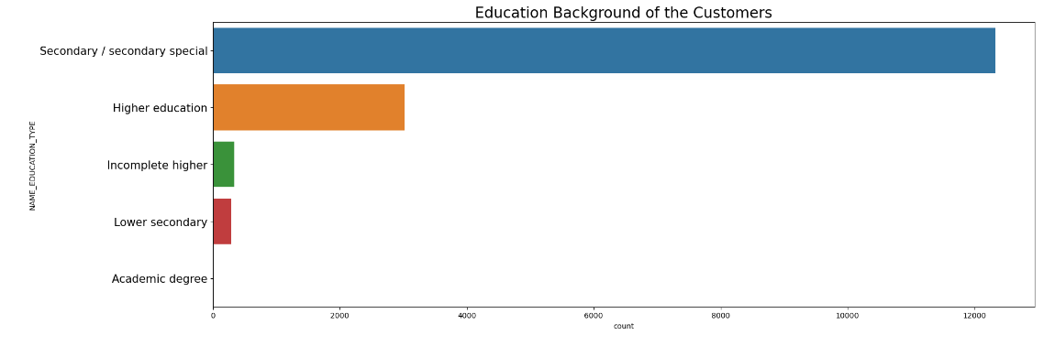
Education Background of the Customers of pensioners and Commercial Associate.
The majority of customers are laborers and they had Secondary/Secondary special Education Background.

Slide 34
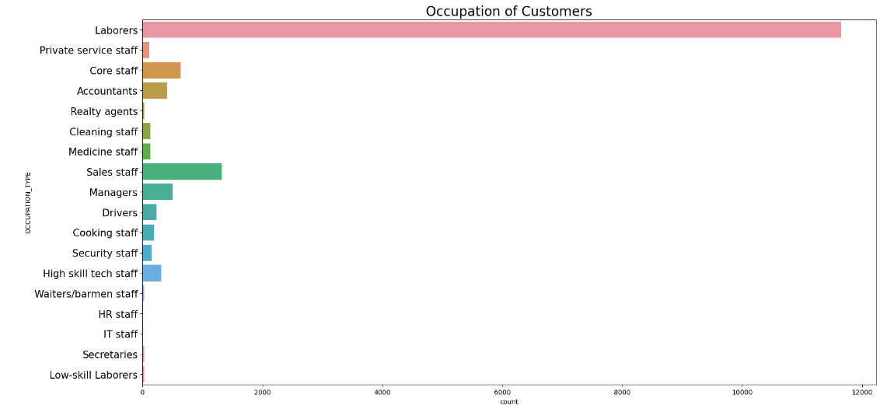
Occupation Type of Customers of pensioners and commercial associate.
Almost 12000 Customers are Laborers

Slide 35
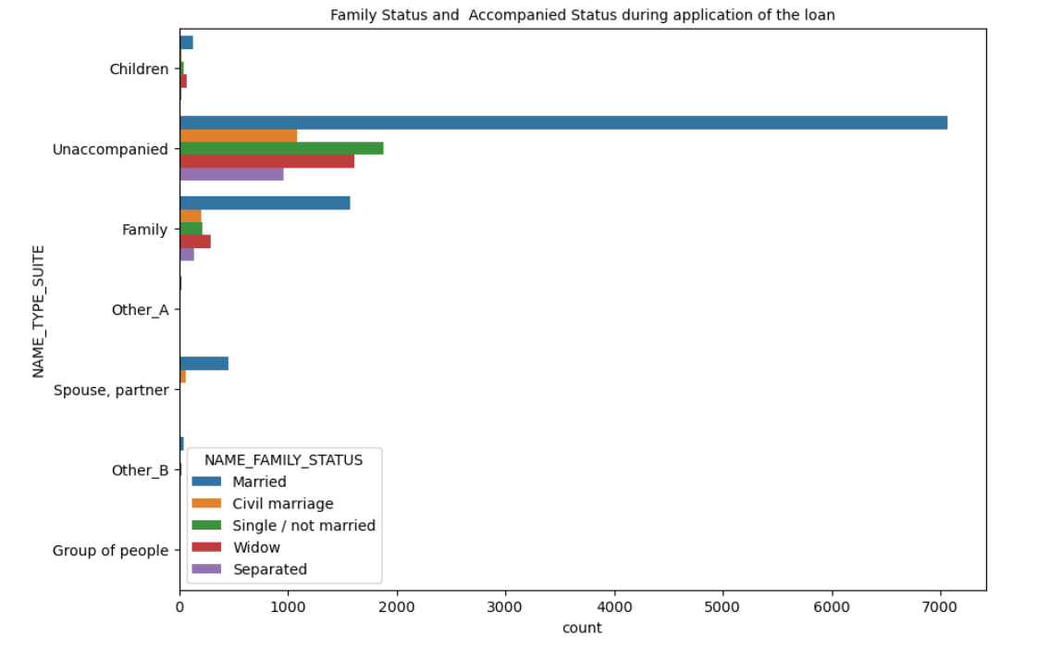
Family Status and were Accompanied Status during application of the loan of pensioners and commercial associate.
The majority of customers are married and were not accompanied by anyone when they came to apply for the loan.

Slide 36
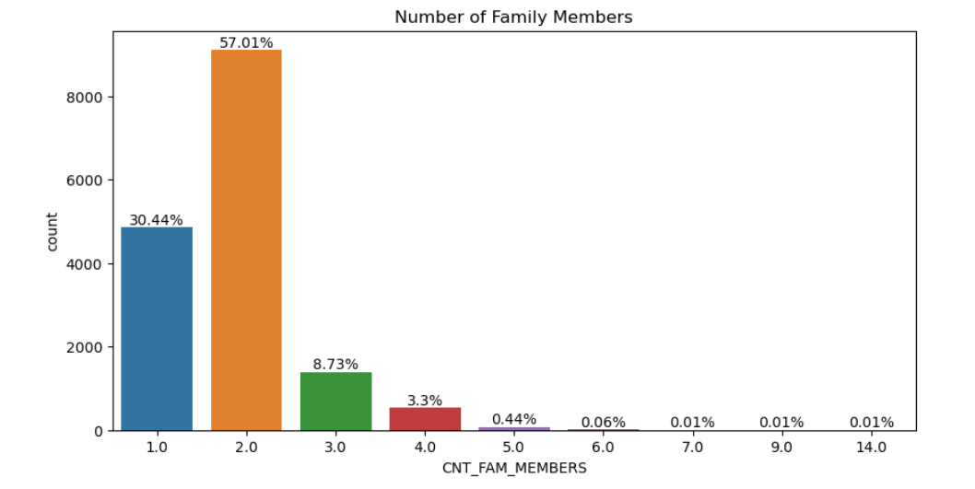
Number of Family Members of pensioners and commercial associate.
57.01 % Customers have 2 Family Members.

Slide 37
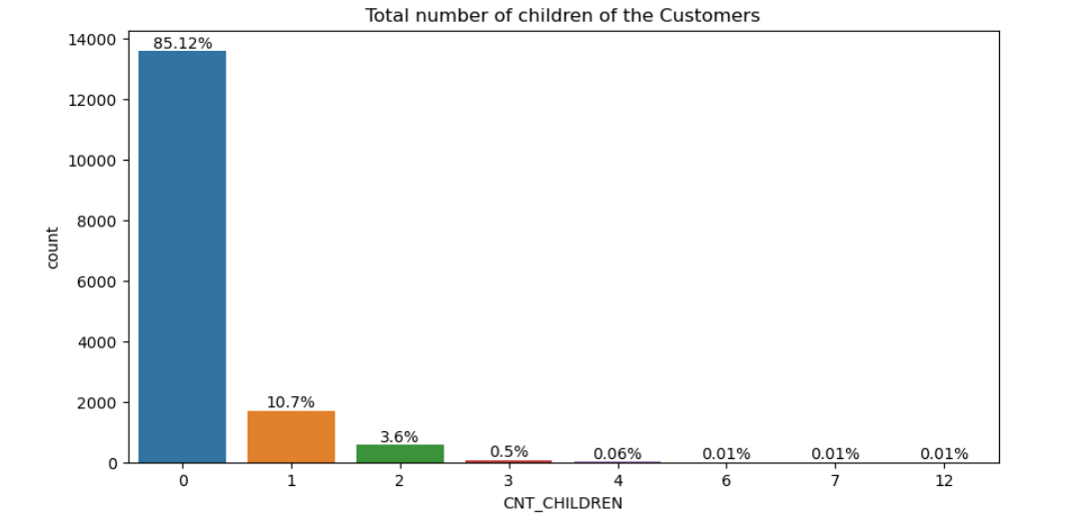
Number of Children of pensioners and commercial associate.
85.12% Customers have No children.

Slide 38
Central Tendency of Income and Credit Data of pensioners and commercial associate.
Credit Amount
Income Amount
Gender | Mean | Median | Std.Deviation | Mean | Median | Std.Deviation
Female | 590959.26 | 521280.0 | 374322.46 | 142020.58 | 135000.0 | 62268.47
Male | 603102.03 | 521280.0 | 378690.33 | 160000.07 | 157500.0 | 68517.23
The mean credit amount for females is slightly higher than that for males, but the standard deviation is also higher, indicating that there is more variability in the credit amounts for females. The median credit amount for females is lower than that for males, suggesting that there may be more females with lower credit amounts compared to males.

Slide 39
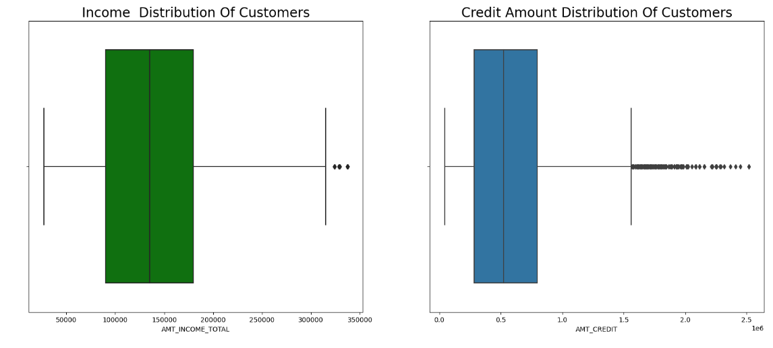
Credit Amount and Income Distribution Of pensioners and Commercial Associate.
Income is between 100000 and 180000 for maximum number of employees.
Credit amount is between 250000 and 750000 for maximum number of employees

Slide 40
Cash Loan May or May not be given on Case by Case Basis- 1.The customers were married laborers from the pensioners and commercial associate. 2.They owned a house but did not have a car. 3.They were unaccompanied when they came to apply for the loan. 4.Their income was less than the credit amount. 5.The goods price was almost equal to the credit amount. 6.83.75% Are Females among these Customers. Family information 1. 85.12% customers had no children. 2. 57.01% Customers had 2 family members. This may suggest that the customers are retired or have lower income sources, which could be a negative factor The fact that the customers are married may suggest that they have stable employment and income sources,. Lending decisions should be made on a case-by-case basis, taking into consideration various factors based on financial and personal information
Takeaways

Slide 41
SUMMARY
DEFAULTERS
NON-DEFAULTERS
Cash Loan should be Rejected 1. The customers were married laborers from the working class. 2.They owned a house but did not have a car. 3.They were unaccompanied when they came to apply for the loan. 4.Their income was less than the credit amount. 5.The goods price was almost equal to the credit amount. 6. 53.21% were females among these defaulters. Family Background
1. 62.42% customers had no children. 2. 45.34% customers had 2 family members. 1.Income is less than the credit amount could be viewed as a negative factor, as it suggests that they may have difficulty making payments on the loan if it is granted. 2.The fact that the goods price is almost equal to the credit amount could be viewed as a potential risk factor, as it suggests that the customers may not have much financial assets. 3.While the customers own a house, they do not have a car, which means that they may not have sufficient collateral to secure the loan.
Cash Loans Should be given. 1.The customers were married laborers from the working class. 2. They owned a house but did not have a car. 3. They were unaccompanied when they came to apply for the loan. 4. Their income was less than the credit amount. 5.The goods price was almost equal to the credit amount. 6. 60.96% were females among these Customers. Family Background
1. 66.39% customers had no children. 2. 50.15 Customers had 2 family members. 1.The fact that the customers are married laborers from the working class may suggest that they have stable employment and income sources, which could be viewed as a positive factor. 2.The fact that the customers own a house but do not have a car may suggest that they prioritize housing over other types of assets, which could also be viewed as a positive factor.
Cash Loan May or May not be given on Case by Case Basis-
1.The customers were married laborers from the pensioners and commercial associate. 2.They owned a house but did not have a car. 3.They were unaccompanied when they came to apply for the loan. 4.Their income was less than the credit amount. 5.The goods price was almost equal to the credit amount. 6.83.75% Are Females among these Customers. Family Background
1. 85.12% customers had no children. 2. 57.01% Customers had 2 family members. 1.This may suggest that the customers are retired or have lower income sources, which could be a negative factor The fact that the customers are married may suggest that they have stable employment and income sources,. 2.Lending decisions should be made on a case-by-case basis, taking into consideration various factors based on financial and personal information

Slide 42
THANK YOU

